Slide 1


Unit
4
ETHNIC GROUPS OF VIET NAM
LESSON 4: COMMUNICATION

Slide 2
* WARM-UP:
Matching
Khmer
Nung
Hoa
Hmong
Brau
Ede
Cham
Tay
1.
2.
3.
4.
5.
6.
7.
8.

Slide 3
* WARM-UP:
Matching
Tay
1.
Nung
4.
Brau
2.
3.
Hmong
Khmer
5.
6.
Hoa
Ede
7.
8.
Cham

Slide 4
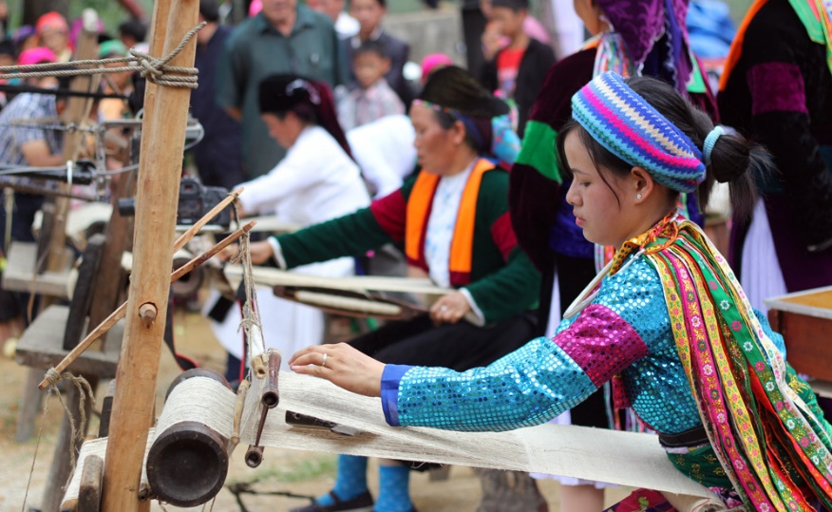
* Vocabulary
- weave (v):
dệt, đan
/wi:v/

Slide 5
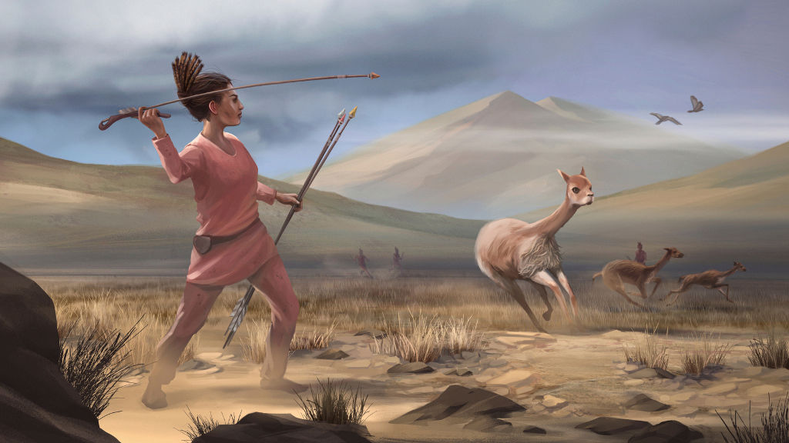
* Vocabulary
- hunt (v):
săn, săn đuổi
/hʌnt/

Slide 6
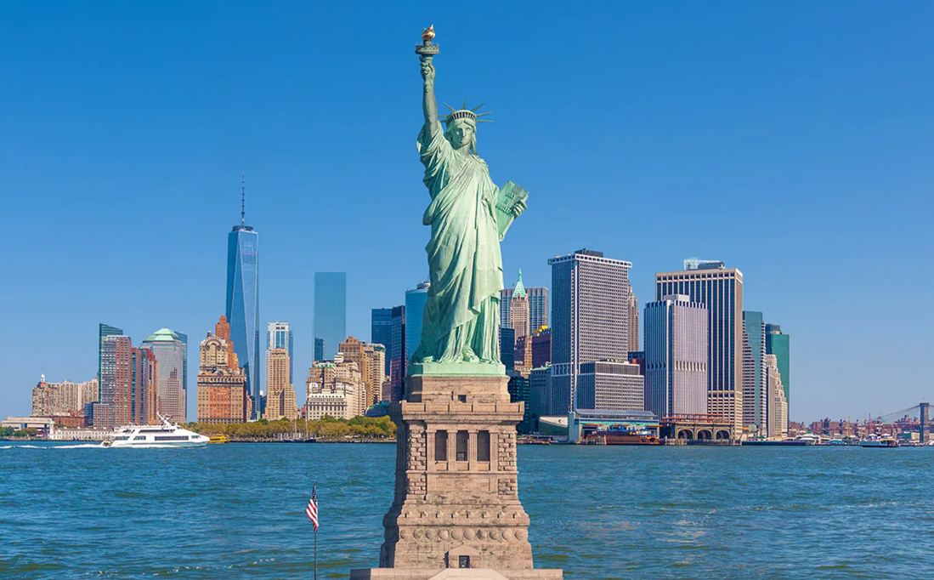
* Vocabulary
- statue (n):
tượng
/ˈstætʃuː/

Slide 7
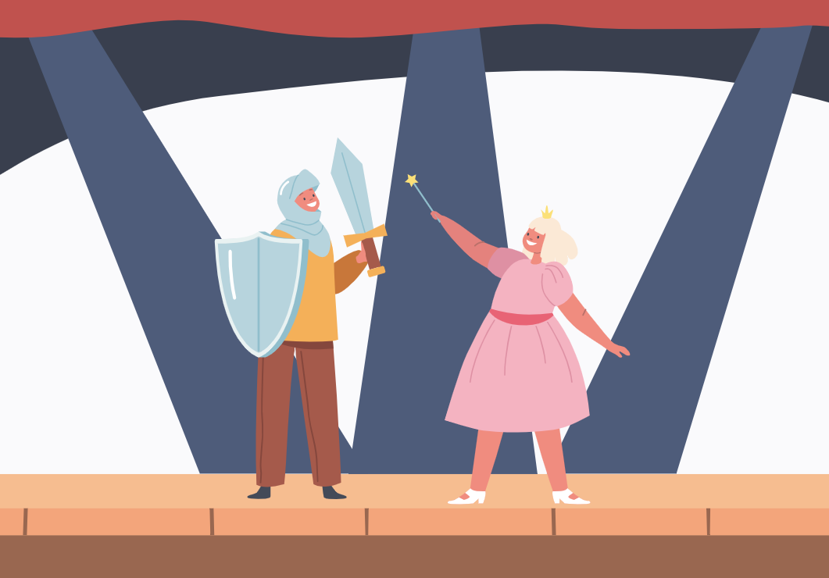
* Vocabulary
- role (n):
vai trò
/rəʊl/

Slide 8
* Vocabulary
New words | Pronunciation | Meaning
1. weave (v) | /wiːv/ | dệt, đan
2. hunt (v) | /hʌnt/ | săn, săn đuổi
3. statue (n) | /ˈstætʃuː/ | tượng
4. role (n) | /rəʊl/ | vai trò

Slide 9
* Vocabulary
New words | Pronunciation | Meaning
 | /wiːv/ | dệt, đan
 | /hʌnt/ | săn, săn đuổi
 | /ˈstætʃuː/ | tượng
 | /rəʊl/ | vai trò
1. weave (v)
2. hunt (v)
3. statue (n)
4. role (n)

Slide 10

* EVERYDAY ENGLISH
1
Listen and read the conversations. Pay attention to the highlighted parts.
Tom: What do you think about life in the mountains?
Trang: I think it’s very interesting. People in the mountains live close to nature.
Tom: What about you, Mai? What do you think?
Mai: To my way of thinking, there are better services in the city.

Slide 11
* EVERYDAY ENGLISH
Structures giving opinions:
- I think …
- To my way of thinking …

Slide 12
* EVERYDAY ENGLISH
2
Work in pairs. One asks the questions and the other gives opinions about these topics.
Playing traditional games
Living close to nature

Slide 13
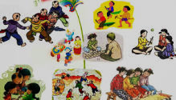
* EVERYDAY ENGLISH
2
Work in pairs. One asks the questions and the other gives opinions about these topics.
Playing traditional games
Tom: What do you think about life in the mountains?
Trang: I think it’s very interesting. People in the mountains live close to nature.
Tom: What about you, Mai? What do you think?
Mai: To my way of thinking, there are better services in the city.

Slide 14
* EVERYDAY ENGLISH
2
Work in pairs. One asks the questions and the other gives opinions about these topics.
Playing traditional games
A: What do you think about playing traditional games?
B: I think it's very interesting. Children always love playing traditional games.
A: What about you, C? What do you think?
C: To my way of thinking playing traditional games will bring people together

Slide 15
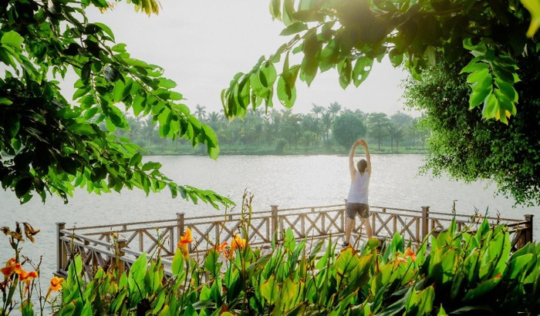
* EVERYDAY ENGLISH
2
Work in pairs. One asks the questions and the other gives opinions about these topics.
Living close to nature
Tom: What do you think about ……………………………………?
Trang: I think ……………………………………………………………….
Tom: What about you, Mai? What do you think?
Mai: To my way of thinking, ……………………………………………………..

Slide 16

3
How much do you know about ethnic groups in Viet Nam?

Slide 17
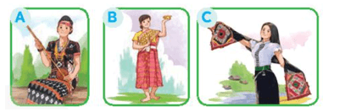
3
How much do you know about ethnic groups in Viet Nam?
1. There are ____________ ethnic groups in Viet Nam.
A. 63 B. 45 C. 54
2. Ethnic minority groups form about ____________ of the total population of Viet Nam.
A. 7% B. 13% C. 25%
3. They mainly live ____________.
A. in the lowlands B. in the mountains C. in the Mekong Delta
4. The Jrai decorate houses for the dead with a lot of ____________.
A. wood statues B. flowers C. colourful pictures
5. The Khmer mostly earn their living from weaving and _____________.
A. farming B. hunting C. fishing
6. Picture ____________ shows a Thai woman's costume.

Slide 18
3
How much do you know about ethnic groups in Viet Nam?
0
10
9
8
7
6
5
4
3
2
1
CHOOSE THE BEST ANSWER
1. There are ____________ ethnic groups in Viet Nam.
⬧
a
63
b
45
K
c
54
Notes:
18

Slide 19
3
How much do you know about ethnic groups in Viet Nam?
0
10
9
8
7
6
5
4
3
2
1
CHOOSE THE BEST ANSWER
2. Ehnic minority groups form about __________ of the totl population of Viet Nam.
⬧
a
7%
b
13%
c
25%
K
Notes:
19

Slide 20
3
How much do you know about ethnic groups in Viet Nam?
0
10
9
8
7
6
5
4
3
2
CHOOSE THE BEST ANSWER
1
3. They mainly live ____________.
⬧
a
in the lowlands
b
in the mountains
K
c
in the Mekong Delta
Notes:
20

Slide 21
3
How much do you know about ethnic groups in Viet Nam?
0
10
9
8
7
6
5
4
3
2
1
CHOOSE THE BEST ANSWER
4. The Jrai decorate houses for the dead with a lot of ____________.
⬧
a
wood statues
b
flowers
K
c
colourful pictures
Notes:
21

Slide 22
3
How much do you know about ethnic groups in Viet Nam?
0
10
9
8
7
6
5
4
3
2
1
CHOOSE THE BEST ANSWER
5. The Khmer mostly earn their living from weaving
and _____________.
⬧
a
farming
b
hunting
K
c
fishing
Notes:
22

Slide 23
3
How much do you know about ethnic groups in Viet Nam?
0
10
9
8
7
6
5
4
3
2
1
CHOOSE THE BEST ANSWER
6. Picture ____________ shows a Thai woman's costume.
⬧
a
b
c
K
Notes:
23

Slide 24
3
How much do you know about ethnic groups in Viet Nam?
1. There are ____________ ethnic groups in Viet Nam.
A. 63 B. 45 C. 54
2. Ethnic minority groups form about ____________ of the total population of Viet Nam.
A. 7% B. 13% C. 25%
3. They mainly live ____________.
A. in the lowlands B. in the mountains C. in the Mekong Delta
4. The Jrai decorate houses for the dead with a lot of ____________.
A. wood statues B. flowers C. colourful pictures
5. The Khmer mostly earn their living from weaving and _____________.
A. farming B. hunting C. fishing
6. Picture ____________ shows a Thai woman's costume.

Slide 25
* LIFESTYLE OF THE ETHNIC MINORITY GROUPS
4
Work in pairs. Read the information below about the Jrai. Take turns to ask and answer about the information.
A:What is the population of the Jrai?
B:
A: Where do the Jrai live?
B:
A: What kind of house does Jrai live in?
B:
A: Who plays the dominant role in the family?
B:
A: What are they traditional culture?
B:

Slide 26
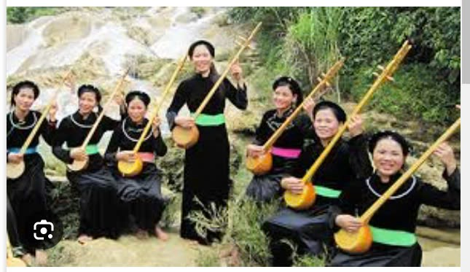
Today, we’re going to learn about The Tay

Slide 27
 | The Tay
Population | 1.845.492 (2019), the second largest ethnic group of Viet Nam
Living place | Mainly in the northern midland and mountainous provinces
Houses | Stilt houses
Economy | Knitting, weaving, planting industrial trees (tobacco, tea leaf,…), woodworking, …
Traditional culture | -Rich in traditional art like: songs, folk dances. games, musical instruments,… -Costume: Mainly made of black indigo fabric, with a few decorative parterns

Slide 28

* LIFESTYLE OF THE ETHNIC MINORITY GROUPS
5
Work in groups. Share with your group the information about the Jrai people you find interesting.
I like … because …
I think that …

Slide 29
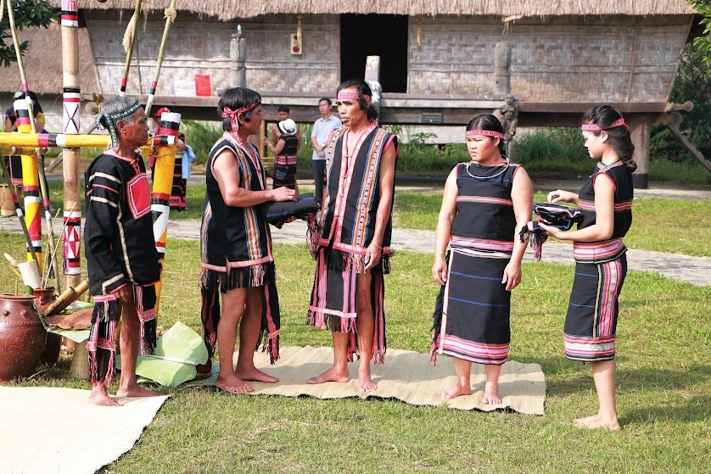
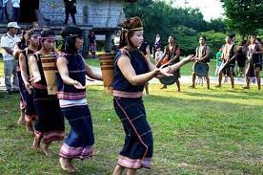
* LIFESTYLE OF THE ETHNIC MINORITY GROUPS
5
Work in groups. Share with your group the information about the Jrai people you find interesting.
- I like the way the use bamboo trees to make the stilt house because it’s very environmental friendly.
- I think that women play the dominant role in the Jarai family is a radical thought.

Slide 30

* CONSOLIDATION
In this lesson, we have:
learnt new words related to the life of the ethnic people.
learnt how to give opinions.

Slide 31

* Homework
Learn by heart all the words.
Do exercises in the workbook.
Prepare for Lesson 5 – Skills 1.

Slide 32

Unit
HOBBIES

